Slide 1
What is Management Information System?
MIS is defined as the system which provides information to the management on the regular basis in the right form to facilitate the decision making.
It is combination of data and resources that stores and retrieves, transforms, disseminates information in an organization.

Slide 2
Objective of MIS:
To provide information to the business professionals in a variety of easy to use formats.
To help in making right decision through accurate data analysis.
To dissipates the accurate and timely information to concerned people quick, easily, and at low cost.
Ease in proper recording, manipulation of data.

Slide 3
Introduction to WEBPAGE (CMS) System:
We have used the concept of MIS to developed the information management system of the college/ or any academic (educational) institutions.
COLLEGE MANAGEMENT SYSTEM as it is developed with a view to provide a college with the reliable , efficient, applicable and secured system for the storage, transforms, modification of the all data available.

Slide 4
Objective of CMS web system
For the quick and easy accessibility of the up-to-data information’s... and many more.
To provide right information to the right person,
To enhance the communication between the college members, staff, students, administrations, teachers

Slide 5
Use of web based application for CMS
*Every sector / or every field are upgraded to web based applications programs.
Using CMS through web application minimizes the cost of data storage, data retrieval.
Provides quick access to the information from any area.

Slide 6
Tools / Language used
Language Used : PHP (PHP: Hypertext Preprocessor)
Database Used : MySQL database
Server Used : Apache (XAMPP)
IDE Used : Dreamweaver, Photoshop
* CSS implementation for designing

Slide 7
Chief Features of the system:
Dynamisms in case that the main designing of the system is its database, the data are retrieved through, manipulate and dropped from it.
Secured cause, use of log in system to prevent unauthorized user access.
Daily up gradation of information in database is available, so the system is up-t-date all the time.
Students messaging system that increased in the communication in between them.

Slide 8
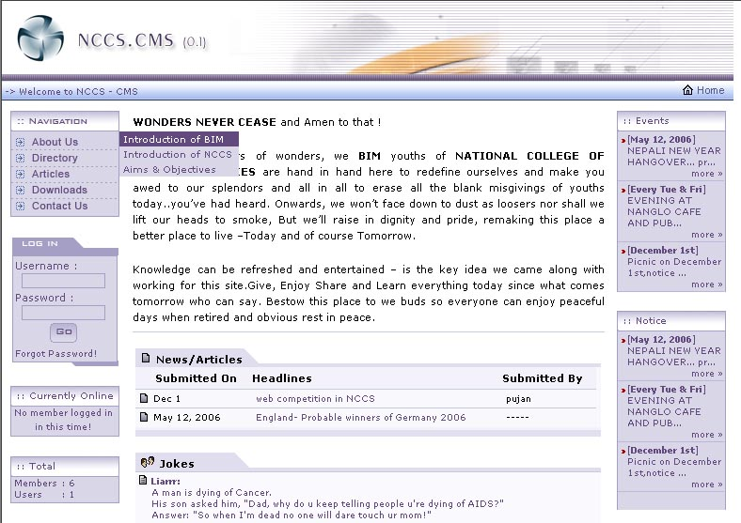
System View
Index page

Slide 9
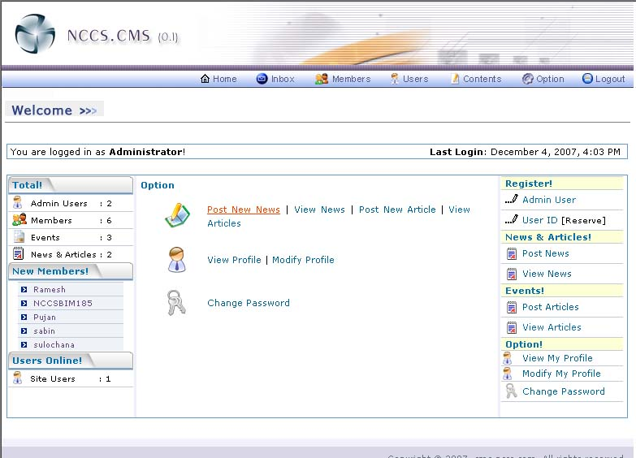
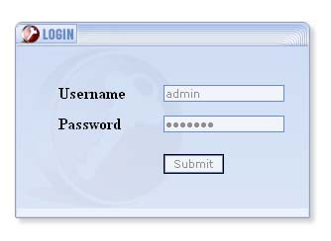
System View
Control Panel
Log in page
Admin Panel
Notes:
Control Panel

Slide 10
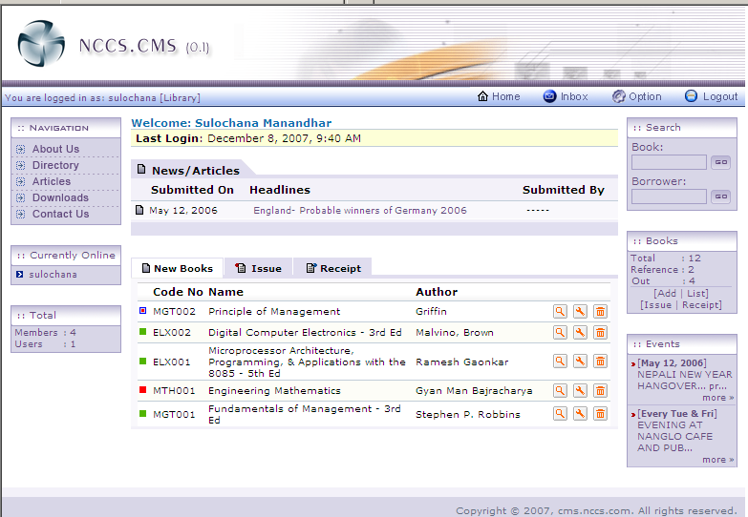
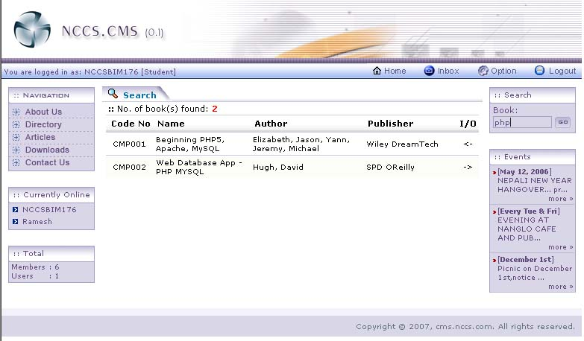
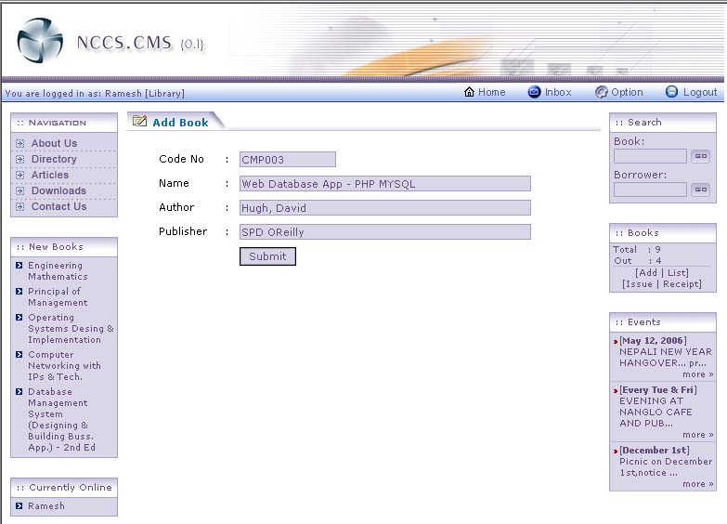
System View
Librarian Page
Student Page
Librarian Add-Book

Slide 11
Program Attributes:
Reliability
It ensures the correct and the appropriate, and the timely information, not just the overloaded information and misinformation
User friendliness
-All the information’s are systematically arranged.
-With just a few click user can have access to what they want
Security
-It prevents the unauthorized alteration of the data.
-Different users are provided with variety of privileged,

Slide 12
Applicabilty:
Mainly developed for the use in academic institutions
May be apply to all kind of business organizations whether big or small where information plays an important role

Slide 13
Future Upgradation
Add yourself as I don’t have the final report soft copy

